Slide 1


Stanford Research Computing
Stats 285 Fall 2018 Cluster computing Introduction and the Sherlock
High Performance Computing Cluster

Slide 3
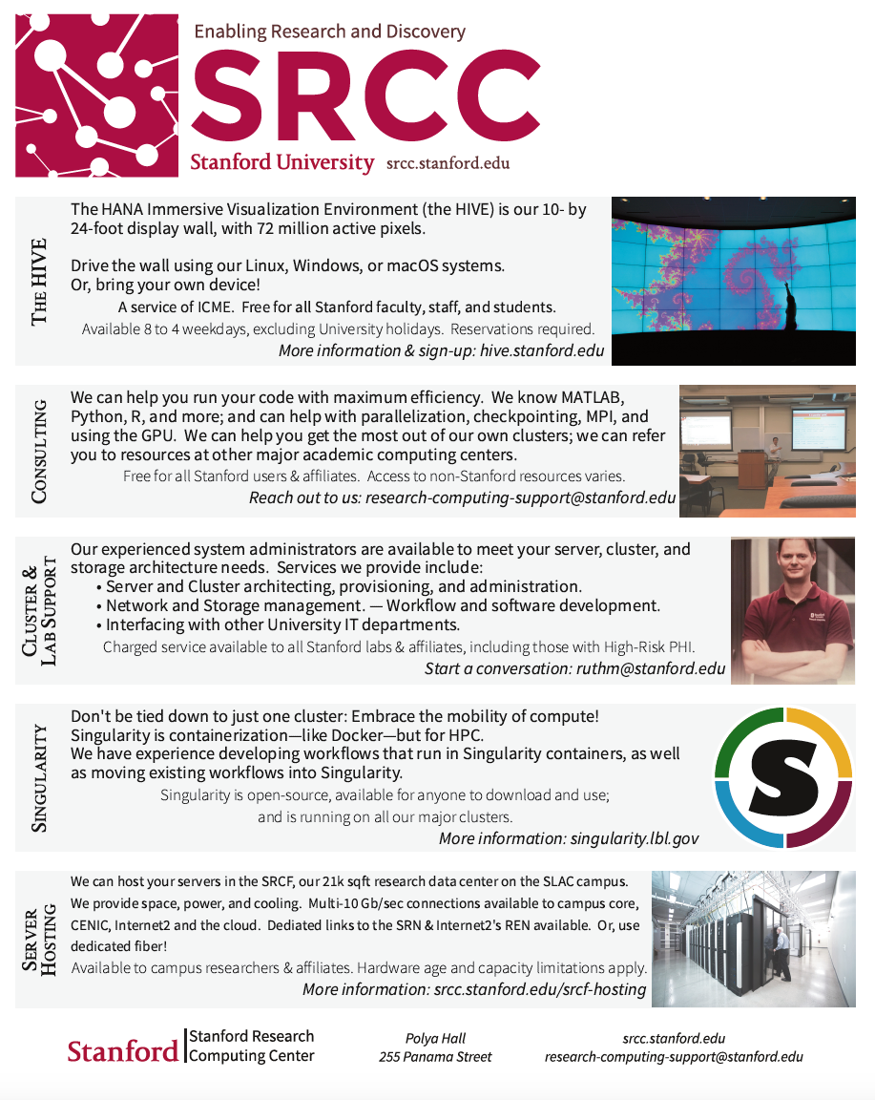

Slide 4
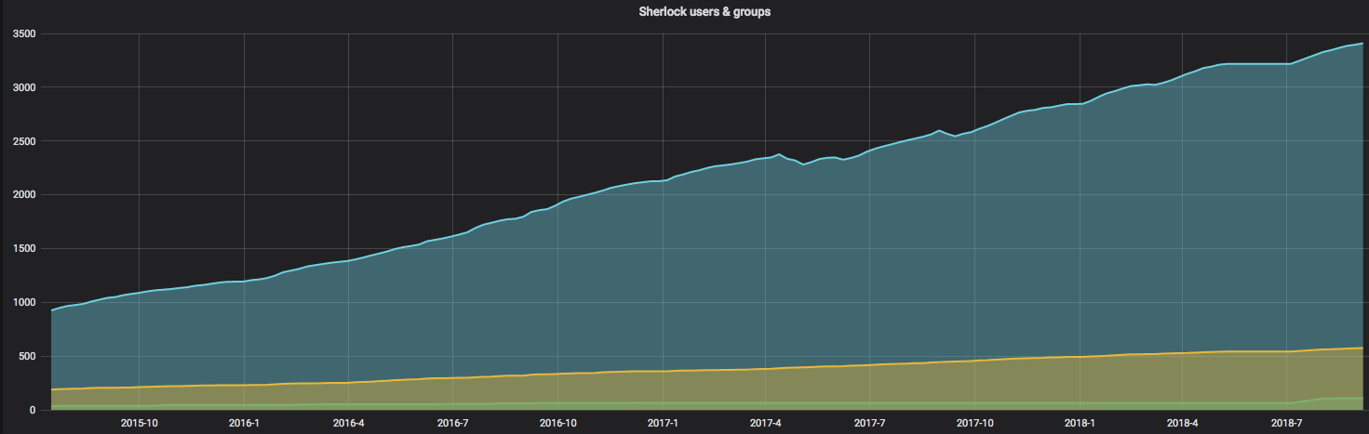
Sherlock’s user growth since 2015

Slide 5
What is High Performance Computing (HPC)
“HPC generally refers to the practice of aggregating computing power in a way that delivers much higher performance than one could get from a typical desktop computer or workstation in order to solve large problems.” – Inside HPC
A computer cluster is a set of connected computers working together so that, in many respects, they can be viewed as a single system. Clusters are composed of nodes set to perform the same task, controlled and scheduled by software.
A distributed system is a system whose components (nodes) are located on different networked computers (via Infiniband, Ethernet), which then communicate and coordinate their actions by passing messages to one other. The components interact with one other in order to achieve a common goal- greater computing power than individual computers.
Parallel computing is a type of computation in which many calculations or the execution of processes are carried out simultaneously. Large problems can often be divided into smaller ones, which can then be solved at the same time.

Slide 6
When will I need it?
When your computing needs are above and beyond what an average laptop or desktop can handle in terms of data storage, CPU, RAM, i/o, availability and networking.
Almost every field of research where simulations, large computation or data is needed: Astrophysics, Machine/Deep Learning, Social Sciences, Biology, Chemistry, Economics. Most common software run: R, Matlab, and Python
As far as the user is concerned: it’s all about power:
[mpiercy@sh-ln04 login! ~]$ sinfo --format=%C
CPUS(A/I/O/T)
20175/2150/1343/23668
(ONL’s Summit has 2,282,544!)

Slide 7
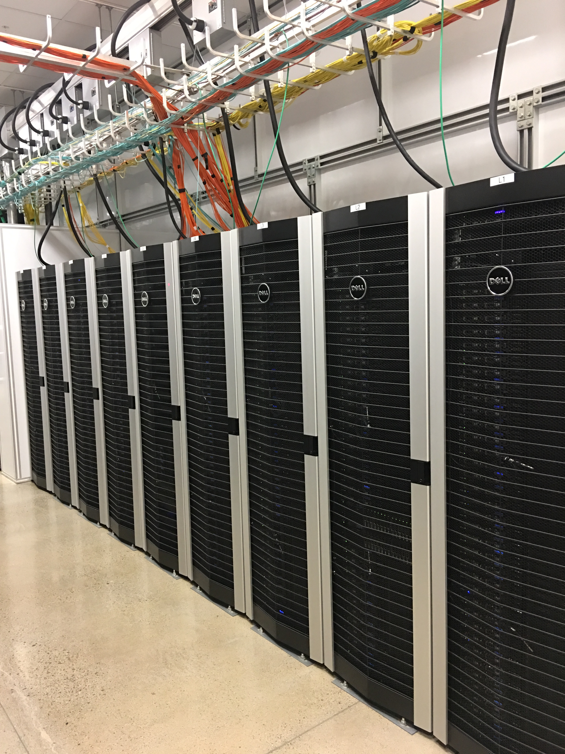
Personal Computers vs. High Performance Computers
Mac Book Pro Laptop
2 cores
16GB RAM
512GB Solid State Disk
High Performance Computers
Typical Sherlock server: 24 CPUs in two sockets Intel 2.4GHz Xeon Skylake CPU, up 512 CPUs can be run at once on Sherlock, 2,048 CPUs for owners.
192GB RAM
20TB scratch storage, 1TB group home, 100GB local Solid State Disk
Infiniband connection 100GB/s
GPU nodes (NVIDIA Kepler K80, K40, Volta V100 )
Big memory nodes (512GB, 1.5 and 3TB RAM)
Notes:
My Computer are specs from a 16 in Mac book Pro 2.9GHz Processor: https://www.apple.com/shop/buy-mac/macbook-pro/15-inch
Please review the HPC specs, they don’t match up with the information found on the Pros/Cons slide

Slide 8
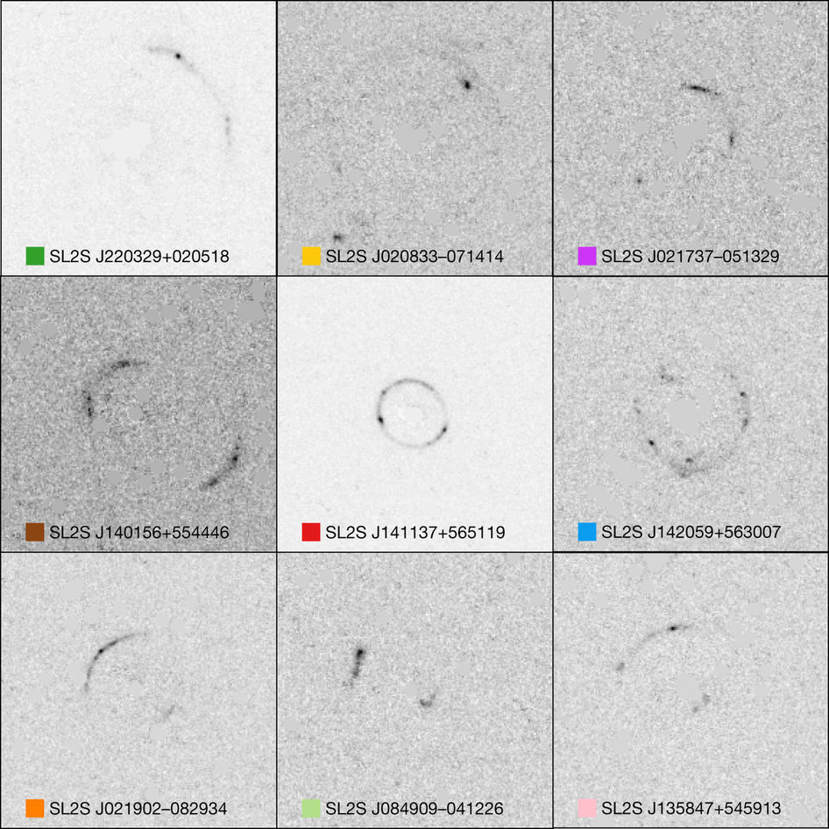
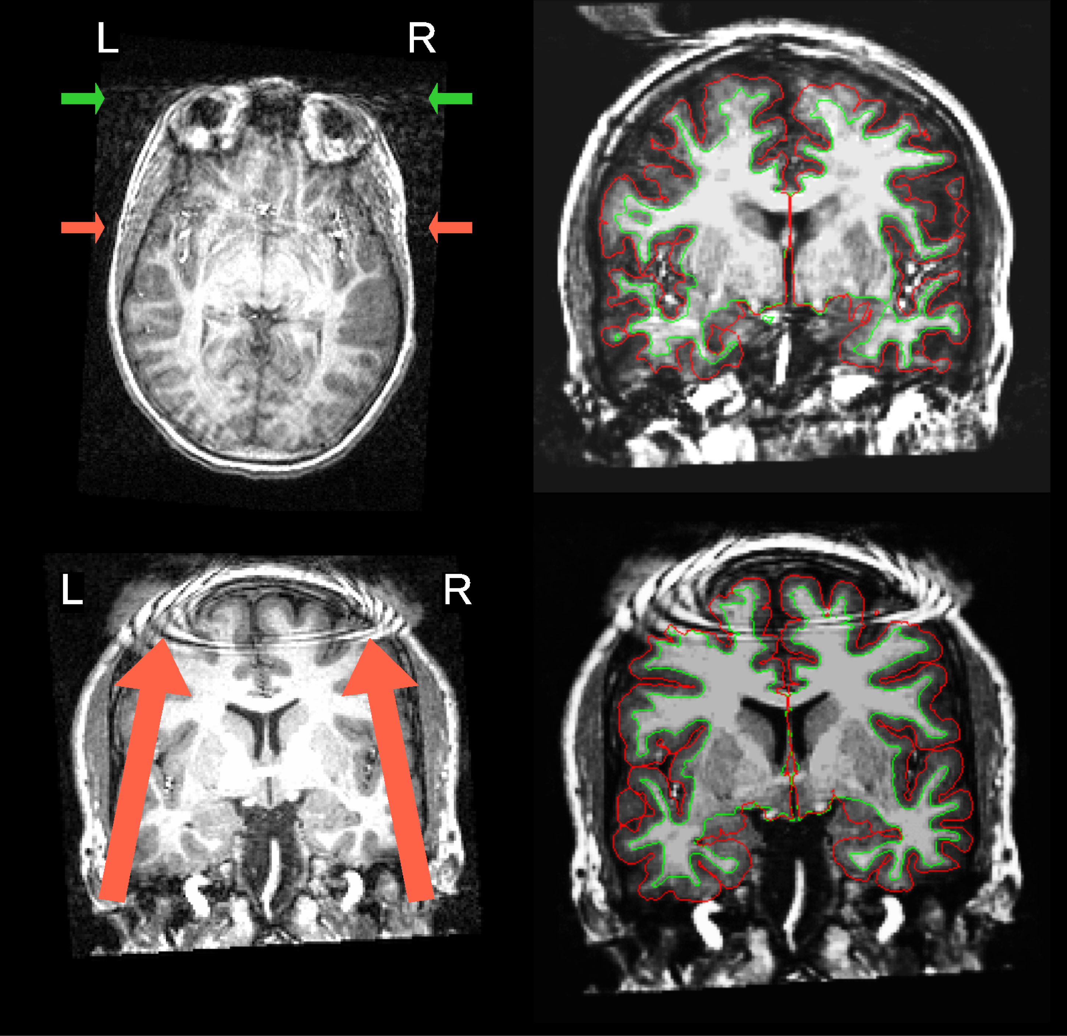
High Performance Computing Use Cases
Analyzing Gravitational Lenses 10 million times faster on Sherlock with neural networks on our GPUs, Advancing the automatic prediction of image quality in MRI from unseen sites, Stanford Open Policing project
https://srcc.stanford.edu/srcc-enabled-publications
Notes:
THIS SHOULD BE ALTERED DEPENDING ON WHICH GROUP YOU’RE PRESENTING TO

Slide 9
Pros and Cons of HPC vs DIY/desktop
Pros-
Your code/calculations are run on servers that are always on, networked and accessible from anywhere by anyone in your PI group (including off campus collaborators with basic SUNetIDs)
High performance parallel file systems- fast i/o, 30TB of group Scratch storage on Sherlock
Much more compute power, hundreds of CPUs, large memory servers up to 3TB of RAM
Data sharing among research groups is easy, Globus for large data transfers
Data in home directories are backed up (snapshotted) and replicated
The job scheduler handles problems with hardware, hardware/nodes can fail but jobs do not, you launch your jobs and log off
Cons-
Need to learn how to use a job scheduler and the Linux command line- aka “The Shell”
Jobs go through a scheduler using the Fairshare algorithm since the system is shared by thousands of users; so you need to wait
Sometimes you need to request and wait for software installs, you will not have the same permissions to change/modify the system as you do on your own laptop, desktop or cloud instance, however often users can install software themselves on Sherlock/Farmshare
Notes:
THIS SHOULD BE ALTERED DEPENDING ON WHICH GROUP YOU’RE PRESENTING TO

Slide 10
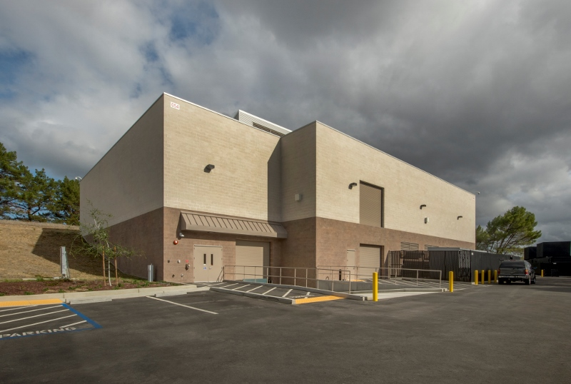
SRCF: Our Data Center
21,000 sq. ft. high density secure computing facility.
10 and 100GB networked
~4,000 servers
Located on the SLAC campus, leading edge energy conservation features
415V power direct to the server cabinets
100% outside air with all outside air relieved from the space via natural convection (zero fan energy for outside air exhaust).

Slide 11
Sherlock System Simple Overview
Infiniband interconnect
generic nodes
sh-ln01
sh-ln02
You- connecting via ssh
sh-ln03
sh-ln04..08
specialized nodes,bigmem, data transfer (DTN)
/home
/scratch -3PB
Login nodes
Filesystems, storage servers
1,360 compute nodes

Slide 12
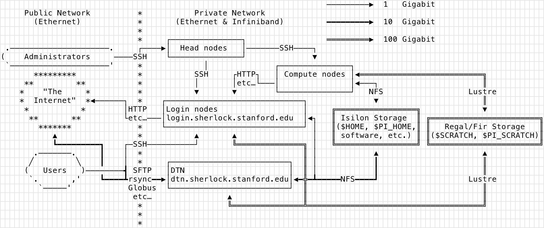
Sherlock: Connecting and Networking Internal and External

Slide 13
HPC Workflows
Research- Many users working on many problems, constantly changing environment. Jobs are heterogenous, many single CPU jobs or large multi-node jobs, large RAM, all types of jobs and software
Interactive- Users login to compute nodes and iteratively test, run their code estimate their codes resource requirements, install/load code dependencies. On Sherlock we use sdev and srun commands for this. When ready, submit the jobs as batch jobs to the pool of compute nodes with sbatch command.
Production- Fewer uses, large scale, thousands, or tens of thousands of CPUs. The details, resource requirements, i/o, performance, have already been worked out. Static unless major changes to inputs or software, astrophysics, fluid dynamics, weather simulations, predictions. Often rely on MPI and more recently GPUs. Often jobs are running parallel across multiple nodes

Slide 14
MPI
Message Passing Interface
Run code across multiple nodes, CPUs, sharing memory
Thousands of CPUs, TB of memory can be used at once
Communication protocol for programming parallel computers runs over 100GB/s Infiniband network on Sherlock nodes are connected via PCI bus
Most MPI implementations consist of a specific set of routines directly callable from C, C++, Python and Fortran
Standardized and Portable, OpenMP and MPICH OpenMP pragmas are added to code
Used in many codes for large simulations, VASP (ab initio simulations), Quantum ESPRESSO, Schrodinger, NWChem
MPI tutorials
http://mpitutorial.com/tutorials/
https://computing.llnl.gov/tutorials/mpi/

Slide 15
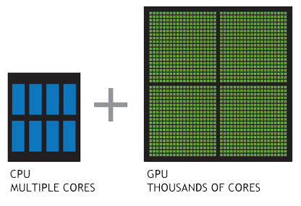
Graphics processing units GPUs
GPUs highly parallel structure makes them
more efficient than general-purpose CPUs for
algorithms where the processing of
large blocks of data is done in parallel.
GPU is specialized for compute-intensive, highly
parallel computation and designed such
that more transistors are devoted to data processing
rather than data caching and flow control.
CUDA and OpenCL used to program GPUs
directly,
The Sherlock cluster features some of the latest generation of GPU accelerators: the NVIDIA Tesla V100.
Each V100 GPU features 7.8 TFlops of double-precision (FP64) performance, up to 125 TFlops for deep-learning applications, 16GB of HBM2 memory, and 300GB/s of interconnect bandwidth using NVLink 2.0 connections.
Three compute nodes, each featuring 4x V100 GPUs, and using a completely non-blocking NVLink topology,

Slide 16
HPC and Cloud workflow comparisons (generalizations)
HPC- Extremely large sets of data, processing the information in parallel while sharing the data between compute nodes. The data connection between the nodes has to be very fast essentially turning the entire grid of nodes into one single “supercomputer”. This requires expensive hardware: nodes with individually high performance. One application can be run across a large number of nodes- vertical scalability.
Cloud (and HPC)- Good for embarrassingly parallel problems. An EPP problem is one in which a data set is divided into pieces which are dispatched to various computers for processing; or, several copies of a smaller data set are distributed across computers to perform different computations on it (e.g. running the application with different parameters). When done, resulting data is re-assembled. Individual computers don’t have to be super fast, the power lies in having a huge number of computers. Several applications (or, copies of the same application) run on several nodes, so horizontal scalability. Run on low cost commodity hardware. Note, these workflows commonly also run on HPC systems- just much faster.

Slide 17
Parallel processing
A very simple example, you have 384 files to zip-
#!/bin/sh
for FILE in *.fastq;
do
sbatch -p normal -t 10:00 --mem=200 --wrap="gzip ${FILE}"
done
Rather than being run serially on 1 or 2 CPU’s on your laptop, on a cluster there are often thousands of CPUs so all 384 files (jobs) are processed (submitted to the scheduler with the sbatch command) at once. The scheduler needs to allocate jobs->resources.
File I/O will be faster, clusters use a parallel filesystem, Lustre
Can also use SLURM Job Arrays
On Sherlock you can run on up to 512 (2,048 for owners) CPUs at once
PS-
This is an example of an embarrassingly parallel problem, little or no effort is needed to separate the problem into a number of parallel tasks. There is little or no dependency or need for communication between the parallel tasks or for the results between them.

Slide 18
Embarrassingly Parallel Examples
Searches in cryptography. Notable real-world examples include distributed.net and proof-of work systems used in cryptocurrency.
BLAST searches in bioinformatics for multiple queries (but not for individual large queries). Sequence alignment, Mutation SNP annotation/discovery
Large scale facial recognition systems that compare thousands of arbitrary acquired faces (e.g., a security or surveillance video via closed-circuit television) with similarly large number of previously stored faces (e.g., a rogues gallery or similar watch list).
Computer simulations comparing many independent scenarios.
Tree growth step of the random forest machine learning technique.
Convolutional neural networks running on GPUs.
Hyperparameter grid search in machine learning.
For embarrassingly parallel problems true HPC with ultrafast interconnects, parallel storage etc. not always needed, but lots of CPUs are.

Slide 19
Cloud (AWS, GCP, Azure) versus HPC (Sherlock, Farmshare)
Cloud
Pros
Fast access, pay as you go, small up front costs, scalable, not buying hardware
No need to learn a job scheduler
No waiting for resources not competing with hundreds of users for CPUs, RAM
You are root/sudo, install anything you want (even if it breaks everything)
Nice UI’s, front ends
Cons
It costs, sometimes these can get very high, CPU hours and data up/downloads will cost
Sometimes does not scale well with the research paradigm
You are root, you can break things and often no one will help you fix them
Some cloud-speak and concepts to learn,
vendor lock-in
Instances run in VMs not bare metal
HPC
Pros
Usually free or very low cost (for users)
Fair amount of free/low cost fast parallel storage i/o is high latencies low
Maintained large research software stack
up/downloading data is free and very fast
User support (free)
Mix of GPU/CPU nodes large mem nodes, 500GB-3TB RAM
Cons
Waiting for resources
Learning a scheduler
Not root/sudo can’t install some software
Resource limits
Cluster concepts to learn

Slide 20
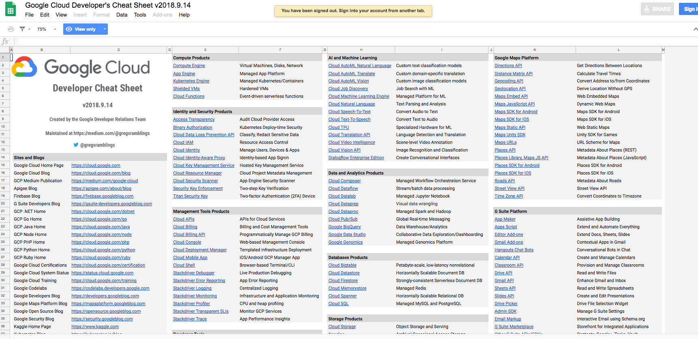
Cloud is getting pretty complex-
https://medium.com/google-cloud/the-google-cloud-developer-cheat-sheet-429775bd6d11

Slide 21
Scheduling Jobs
Why Do We Need to Schedule a Job?
Resource contention between users needs to be balanced. So, the compute resources are managed and workloads are balanced using a job scheduler- SLURM.
How Easy Is It to Schedule a Job?
Basic concept - tell the scheduler:
What resources you need- CPUs, RAM, time, partition
What it should do- load modules, run your code
Need to request as few resources as you need so your jobs pend for as small a time as possible

Slide 22
Sample Batch Job
#!/bin/bash
#SBATCH --job-name=test
#SBATCH --time=10:00
#SBATCH –p normal
#SBATCH --cpus-per-task=1
#SBATCH --mem-per-cpu=2G
#below you can run/call your code, load modules, python, Matlab, R, etc.
# and do any other scripting you want
#lines that begin with #SBATCH are directives to the scheduler-SLURM
srun hostname
srun sleep 60
______________________________________________________________
Edit with vim/nano/vi and save as test.sbatch
To run:
$sbatch test.sbatch
To watch:
$ squeue –u $USER
Many ways to control jobs as they run, scontrol pause/update, scancel,

Slide 23
Common software pre-installed on Sherlock
Matlab
R
Python
Gurobi
423 software packages, in 10 categories, covering 58 fields of science, always growing
All stored as modules-
$module avail
--- math -- numerical libraries, statistics, deep-learning, computer science ---
R/3.4.0 py-keras/2.1.5_py36 (g)
R/3.5.1 (D) py-numpy/1.14.3_py27 (D)
armadillo/8.200.1 py-numpy/1.14.3_py36…

Slide 24
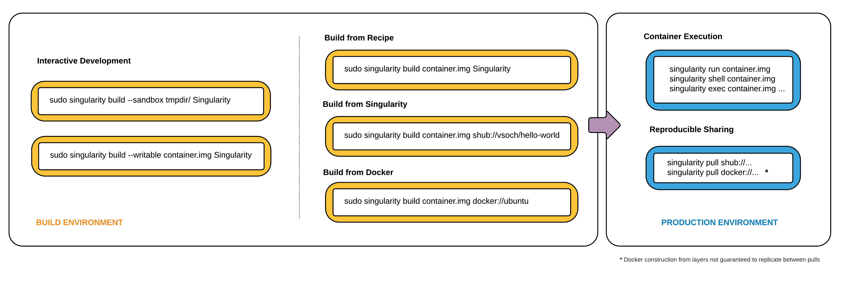
Singularity Containers
Singularity containers are great if you have code/data with many dependencies that you cannot install on a cluster
Build the container as root on your local system then move onto cluster and run
https://www.sylabs.io/docs/

Slide 25
Sherlock Partitions
Partition- a logical and physical set of nodes in a cluster
QOS long (--qos=long, the only QOS needed) jobs >2 days <7 days
What partitions can I run on?
scontrol show partition | egrep -B1 "AllowGroups=.*$(id -gn $user).*" | awk -F= '/PartitionName/ {print $2}’
What’s nodes are on the partition?
sinfo –N –p normal --long
Partition | Number of Nodes
normal | 172
owners | 1,120
hns | 60
bigmem (500GB-3TB RAM) | 4
gpu | 11
dev | 5
Your PI’s own nodes (donoho) | 4

Slide 26
Sherlock Filesystems
Home and Group Home, backed up, snapshotted and replicated offsite
$HOME 15 GB
$GROUP_HOME 1 TB
Scratch- fast Lustre parallel filesystem, your jobs should write/read here (6 month purge policy, unless you have purchased $OAK space- $50 per TB/year)
$SCRATCH 20 TB
$GROUP_SCRATCH 30 TB
$LOCAL_SCRATCH 200GB
Local to your jobs node, even faster, but gets deleted at the end of your job
http://www.sherlock.stanford.edu/docs/user-guide/storage/filesystems/
rclone, gdrive connections to cloud storage

Slide 27
Sherlock User Limits
View the various partition limits with the sacctmgr command-
sacctmgr show qos format=Name,MaxTRESPerUser,MaxSubmitJobsPerUser,MaxJobsPerUser,MaxWall
Name MaxTRESPU MaxSubmitPU MaxJobsPU MaxWall
---------- ------------- ----------- --------- -----------
normal cpu=512 1000 2-00:00:00
dev cpu=2,mem=8G 2 02:00:00
long cpu=32 20 16 7-00:00:00
bigmem mem=3T 10 1-00:00:00
gpu gres/gpu=8 50 2-00:00:00
owner cpu=99999 3000 7-00:00:00
owners cpu=2048 3000 2-00:00:00
donoho cpu=40,gres/+ 3000 7-00:00:00

Slide 28
Sherlock vs. Farmshare
http://www.sherlock.stanford.edu
Available for use by all Stanford faculty and their research teams
Work done must be directly related to the faculty member's research.
A set of servers are free and open to all at Stanford doing sponsored research. Faculty can supplement shared nodes by purchasing additional servers, and become an owner
The owning group will have exclusive use of purchased nodes and access to the over 1,100 owner compute nodes when idle.
http://farmshare.stanford.edu
Primarily intended for use in coursework and unsponsored research
Anyone with a Stanford ID (SUNet ID) can log in
Shared servers
Helps those doing research have a place to test codes and learn about technical solutions to assist in reaching their research goals, prior to scaling up to Sherlock
1,325 compute nodes
24,000 CPU cores
1,195 GPUs
1,590 TFlops
3,400 users
547 research groups
109 Owners
20 128 GB RAM compute nodes.
4 767 GB RAM compute nodes.
10 128 GB RAM nodes with an Nvidia Tesla K40.
Shared storage for your group or class.
Sherlock is approved for Medium Risk. Neither system is approved for use with high-risk data, PHI, or PII.
Notes:
Update the specs of Sherlock vs Farmshare. Use the same terminology/comparisons

Slide 29
The HPC Condo Model
Sherlock PIs can buy 1 or more nodes (starting at about $7,500)
The PI’s group members will have exclusive use of these nodes
Access to idle resources in the owners partition of 1,120 nodes
An owner’s group members will be able to use up to 2,048 CPUs at once
However, jobs in the owners queue are preemptible, if the owner of the node you’re running on wants to use those resources, your job is finished. So these jobs need to be checkpointed in some way. Or at the very least you need to be able to logically aggregate the data at that state and restart processing.
Currently there are 109 owners on Sherlock
Sherlock node orders -https://srcc.stanford.edu/private/sherlock-orders

Slide 30

Future Directions- GIUs and ease of user for HPC
Tools have been developed in order to make accessing HPC resources much easier.
Ohio Super Computing Center has developed Open on Demand.
Users can access an HPC cluster’s shell, launch jobs, Jupyter notebooks, RStudio, edit files all within their web browser.
http://openondemand.org/
Coming soon to Sherlock!

Slide 31
Fairshare Note
Basically the more resources you use- CPU/RAM/Time/Nodes in a 2 week sliding window the lower your Fairshare score is, the more likely your jobs will wait in the queue.
or
A resource scheduler ranks jobs by priority for execution. Each job's priority in queue is determined by multiple factors, among them the user's fairshare score. A user's fairshare score is computed based on a target (the given portion of the resources that this user should be able to use) and the user's effective usage, ie the amount of resources (s)he effectively used in the past. As a result, the more resources past jobs have used, the lower the priority of the next jobs will be. Past usage is computed based on a sliding window and progressively forgotten over time. This enables all users on a shared resource to get a fair portion of it for their own use, by giving higher priority to users who have been underserved in the past.
Sherlock also uses backfill, smaller jobs can go in front of larger jobs regardless of the users Fairshare factor, thus increasing our clusters utilization.

Slide 32
How Can I Obtain Access to HPC?
Sherlock
Your PI or Faculty Sponsor simply needs to request an account - http://www.sherlock.stanford.edu/
Farmshare
Everyone with a full service SUNet ID can access:
Log into rice.stanford.edu using a SSH client
If you have a Mac/PC, open the Terminal application and type: ssh [sunet]@rice.stanford.edu
https://web.stanford.edu/group/farmshare/cgi-bin/wiki/index.php/Main_Page
https://srcc.stanford.edu/farmshare2
Stanford Genomics Cluster-SCG4
Very large bioinformatics stack some free use nodes. A charged service of the Genetics Bioinformatics Service Center
https://web.stanford.edu/group/scgpm/cgi-bin/informatics/wiki/index.php/Scg4_user_guide
UV300 Supercomputer
10 TB of RAM over 360 cores, 4 P100 GPUs
http://med.stanford.edu/gbsc/uv300.html
Notes:
THIS SHOULD BE ALTERED DEPENDING ON WHICH GROUP YOU’RE PRESENTING TO

Slide 33


Other HPC resources for large projects
XSEDE - Extreme Science and Engineering Discovery Environment a powerful, and robust collection of HPC resources and services, a single virtual system that scientists can use to interactively share computing resources, data, and expertise.
https://www.xsede.org/
Open Science Grid-
Facilitates access to HPC clusters. The resources are contributed by the community, organized by the OSG. In the last 12 months, OSG has provided more than 1.2 Billion CPU hours to researchers
https://www.opensciencegrid.org/

Slide 34
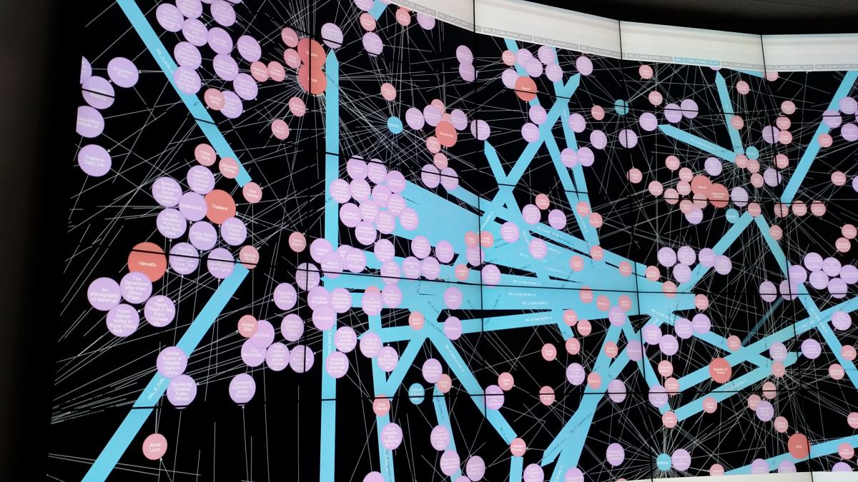
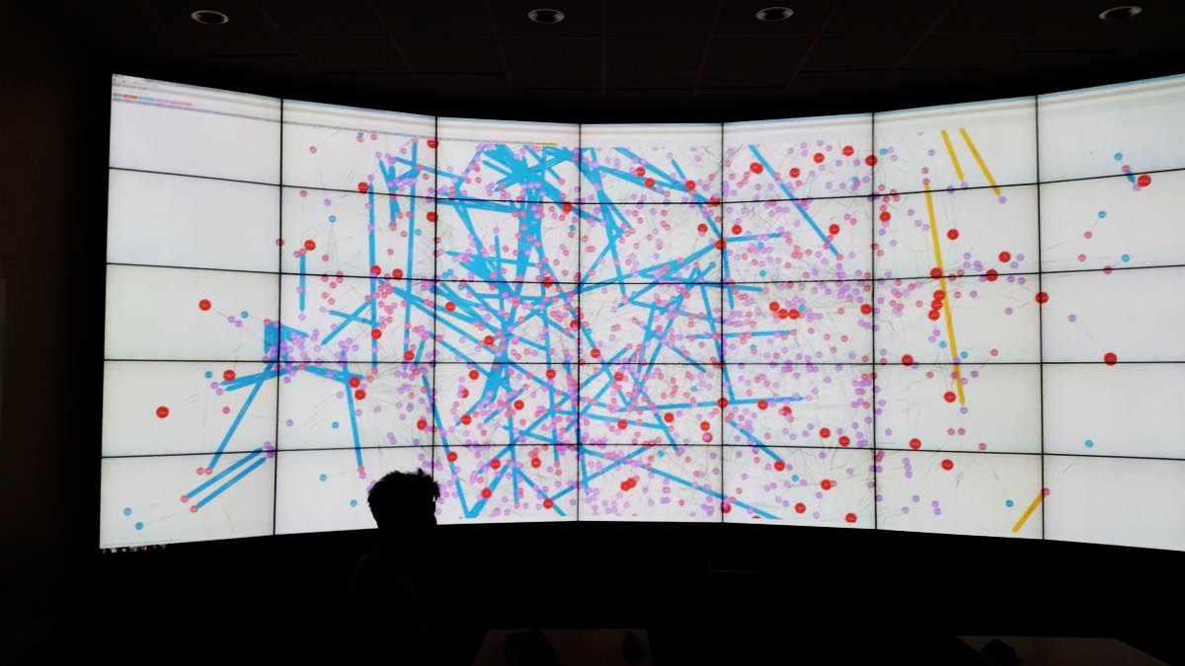
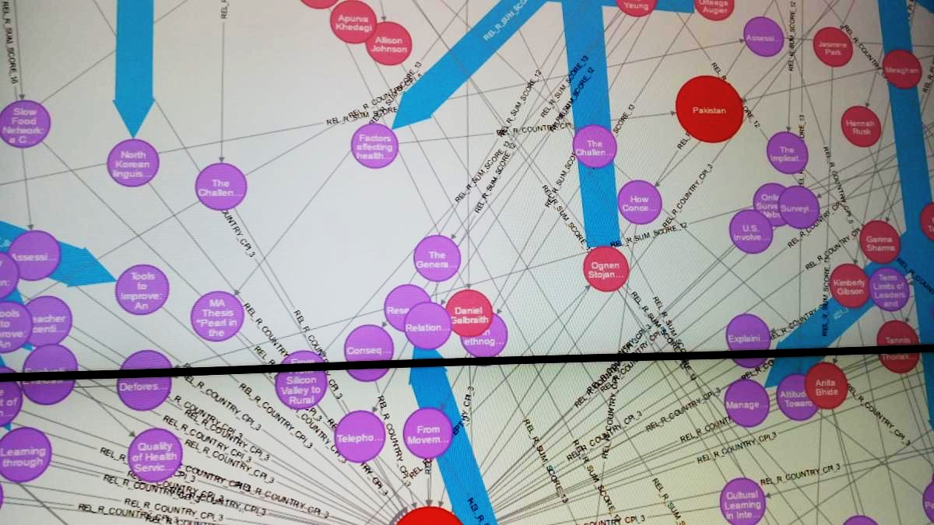
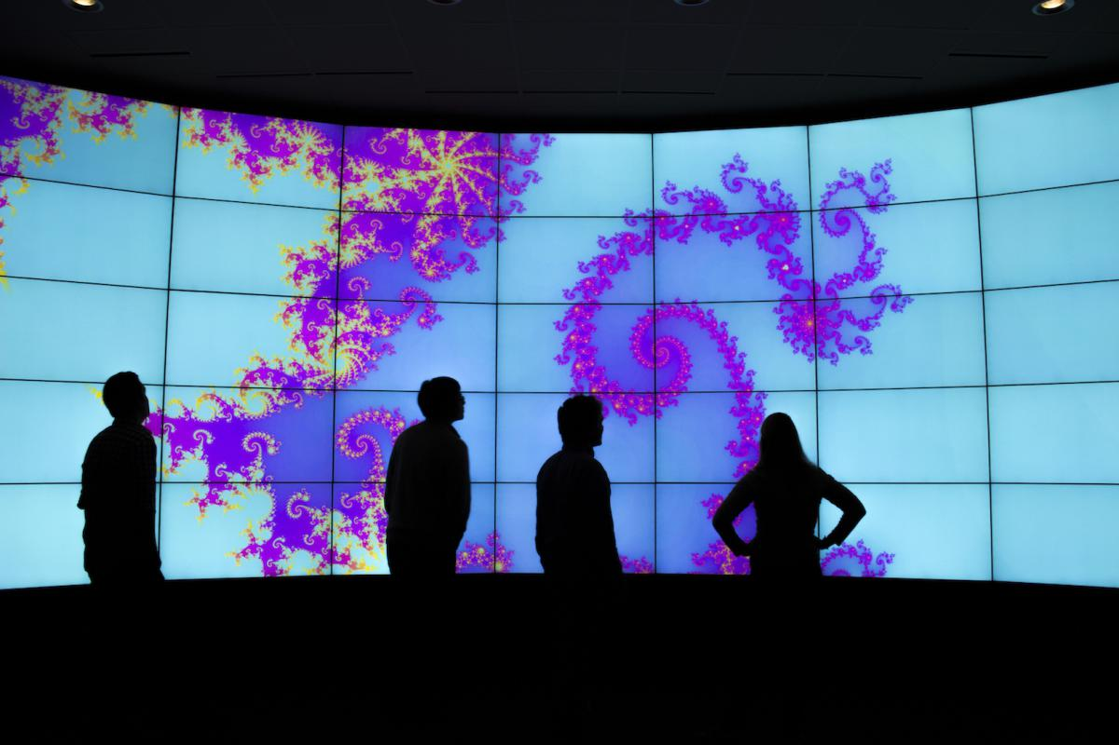
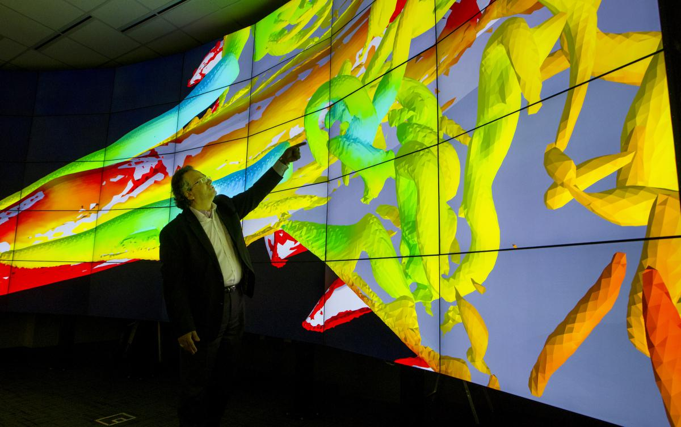
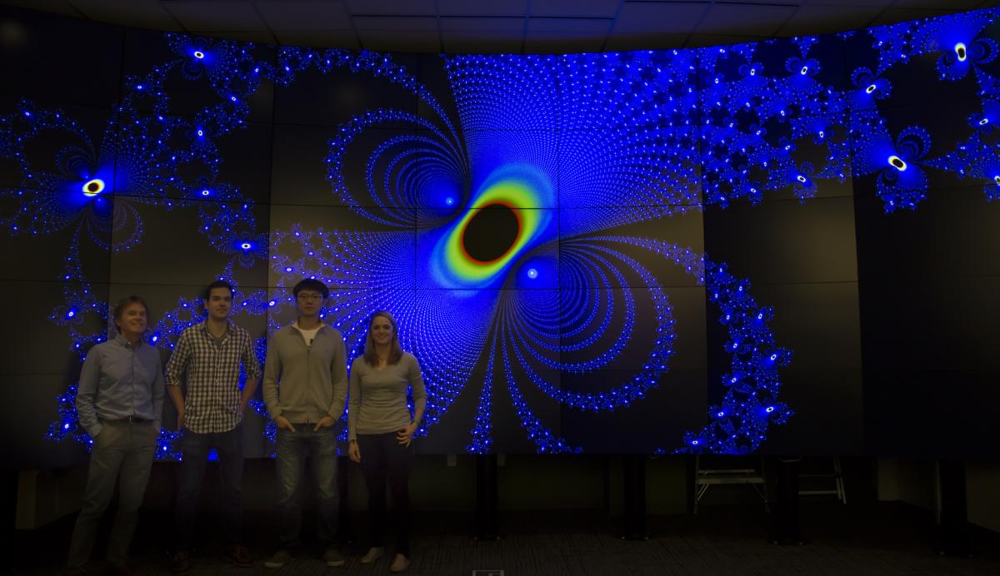
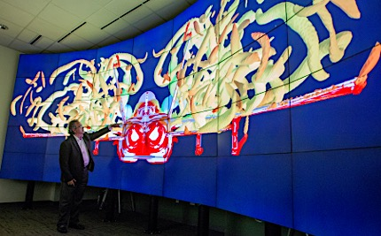
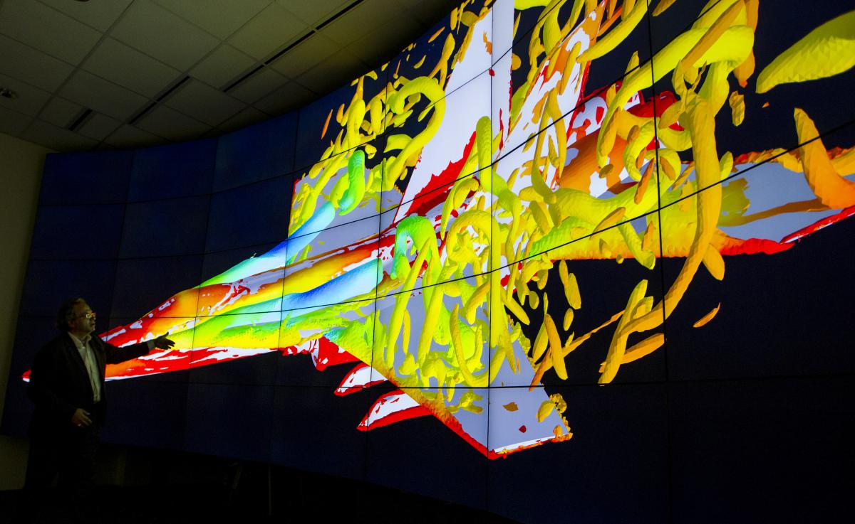
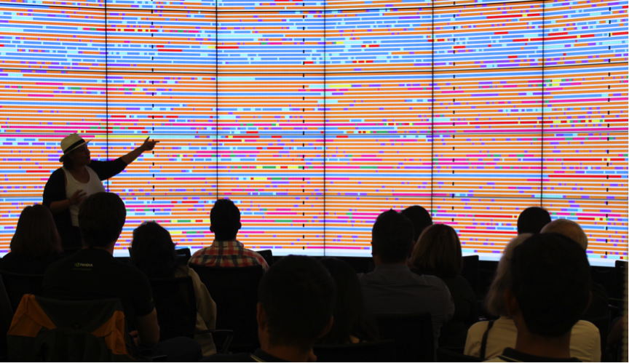
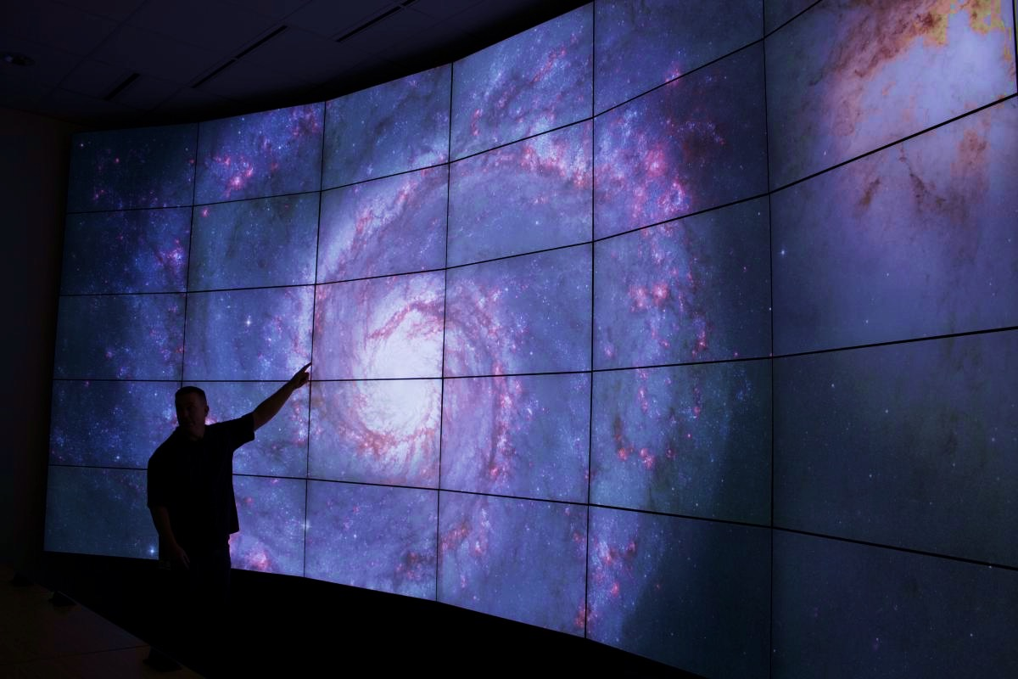
Want to Display Your Work 10x24’ ? Welcome to HIVE
10-foot-tall by 24-feet-wide display with 13440x5400 resolution
and 72 million total active pixels. Located in Huang B050
Use multiple displays simultaneously to investigate various aspects of data collection,
simulation, and visualization and to zoom in to see detail at previously unheard-of-levels. Free to use for teaching, research by any groups at Stanford.
https://icme.stanford.edu/resources/hive

Slide 35
To Learn More
Documentation
Sherlock: http://www.sherlock.stanford.edu/
Farmshare: http://farmshare.stanford.edu
Office Hours
Tuesdays 10:00 - 11:00 am and Thursdays 3:00pm - 4:00pm in room 255 of Polya Hall
Contact
Questions/Answers: srcc-support@stanford.edu
SRCC group: http://srcc.stanford.edu
Mark Piercy: mpiercy@stanford.edu
Notes:
THIS SHOULD BE ALTERED DEPENDING ON WHICH GROUP YOU’RE PRESENTING TO

Slide 36
Links
https://srcc.stanford.edu/srcc-enabled-publications
https://www.sherlock.stanford.edu/docs/overview/glossary/
https://slurm.schedmd.com/
GPUs
https://nyu-cds.github.io/python-gpu/01-introduction/
https://insidehpc.com/2017/03/introduction-gpus-hpc/
https://computing.llnl.gov/tutorials/dataheroes/GPUParallelProgramming.pdf
https://www.youtube.com/watch?v=49DzPT9HFJM
https://storage.googleapis.com/pub-tools-public-publication-data/pdf/43438.pdf
https://medium.com/the-mission/why-building-your-own-deep-learning-computer-is-10x-cheaper-than-aws-b1c91b55ce8c
https://www.top500.org
https://insidehpc.com/

